Slide 1
Sentences
English
Omed Hassan

Slide 2
Sentences
The sentence is the most basic component of any paragraph. You can’t have a paragraph without sentences.
A paragraph composed of a bunch of lousy sentences is not going to be a good paragraph.
The sentence is fundamental. Without sentences, you have no way of paving the road for your reader to follow.

Slide 3
What is a complete sentence?
A complete sentence is a group of words that tells a complete thought.

Slide 4
Ask questions
Ask these questions to determine whether words are a sentence.
1. Does the group of words begin with a capital letter?
2. Do the words make sense?
3. Do the words indicate a complete thought?
4. Does the group of words end with a period, question mark, or exclamation point?

Slide 5
What is a complete sentence?
What is required in every complete sentence?
Capital letter
Subject
Predicate
Complete thought
Terminal Punctuation
Read more at Suite101:
How to Write a Complete Sentence: The Five Parts Needed to Make a Sentence Complete http://www.suite101.com/content/how-to-write-a-complete-sentence-a77972#ixzz17A78lmri
A normal English sentence contains both a subject and a predicate

Slide 6
1.Capital Letter
The first word of a complete sentence must start with a capital letter.
Example:
These days, few students study Latin.

Slide 7

2.Subject
The subject is who or what the sentence is about.
Example:
The dog ate the bone.
In this sentence The dog is the
subject.
Why?
This sentence is about The dog.
We can ask: Who ate the bone?
The dog ate the bone.

Slide 8
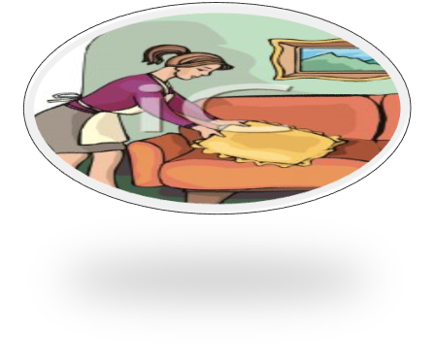
3.Predicate
The predicate tells something about the subject.
Example:
My mother cleaned the living room.
In this sentence cleaned the living room is the predicate.

Slide 9
Predicate
A sentence can be composed of just a subject and predicate.
Example:
Mary sews.
Mary is the subject.
Why?
Mary is being talked about in the sentence.
sews is the predicate.
Why?
The word sews says something about Mary.

Slide 10
4.Complete Thought
A complete thought consists of a general subject (a topic) and the controlling idea on the topic.
For example, the idea could be the speaker's intent, understanding, perspective or opinion about the topic.

Slide 11
Examples: Incomplete Thought
Because his car was in the shop.
(What did he do?)
After the rain stops.
(What then?)
When you finally take the test.
(What will happen?)
Since you asked
(Will you get the answer?)
If you want to go with me.
(What should you do?)

Slide 12
Examples: Incomplete Thought
Does each of these examples have a subject?
Yes
Does each have a verb?
Yes
So what makes the thought incomplete? It's the first word (Because, After, When, Since, If ).
These words belong to a special class of words called subordinators or subordinating conjunctions.

Slide 13
Some sentences can be very short, with only two or three words expressing a complete thought, like this:
John waited.
This sentence has a subject (John) and a verb (waited), and it expresses a complete thought.
We can understand the idea completely with just those two words.

Slide 14

5.Terminal Punctuation
Terminal punctuation is the punctuation that comes at the end of a sentence.
There are three types of terminal punctuation:

Slide 15
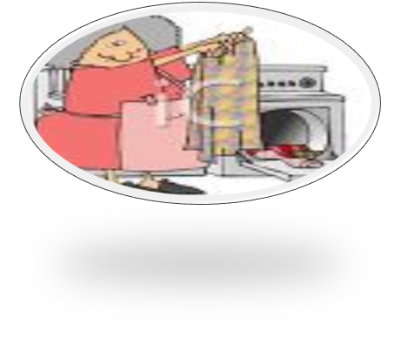

1- Period [.]
Periods end declarative and imperative sentences.
A declarative sentence makes a statement. It
ends with a period.
My pink skirt is very dirty.
The children are happy.

Slide 16

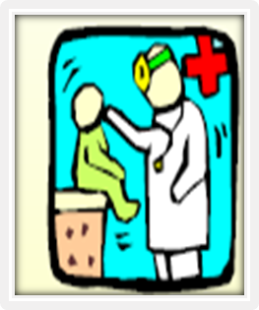
An imperative sentence gives a command or makes a request. It ends with a period.
Please bring the pizza to the table .
1- Period [.]
Open your mouth.

Slide 17

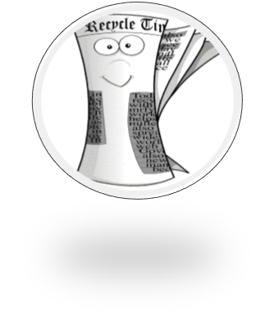


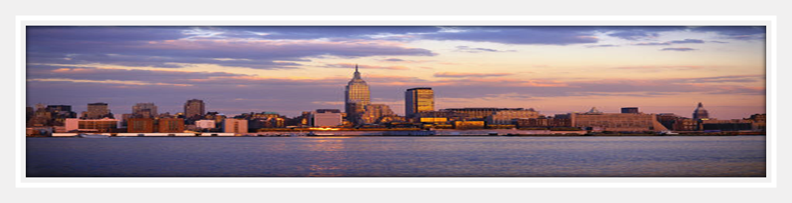
2-Question Mark
An interrogative sentence asks a question .It ends with a question mark.
May I borrow your newspaper
Have you ever visited New York City

Slide 18

3- Exclamation point
Use the exclamation point to show emphasis or surprise.
An exclamation mark usually shows strong feeling, such as surprise, anger or joy.
Using an exclamation mark when writing is rather like shouting or raising your voice when speaking.
Examples:
She shouted at him, "Go away! I hate you!“
He exclaimed:"What a fantastic house you have!"
"Good heavens!" he said, "Is that true?"
"Help!"
"Shut up!"

